Slide 1
Shape Poetry
Suitable for Lower and Upper KS2

Slide 2
Task
If you met an alien and had to give them one object that represented you growing up, what would you give them?
E.g, A football, an Xbox, a teddy, a paint brush…
Why?
Notes:
Activity 5-10 minutes.
Getting children thinking about something that would describe them to an alien. The purpose of this activity is to have children picture an item that they can later scaffold their poems around. Children to write ideas down on paper or a white board (to be used later).
When children have got an idea, get them to state why that would describe them to an alien.
Note down any interesting words that come out from their explanations.

Slide 3
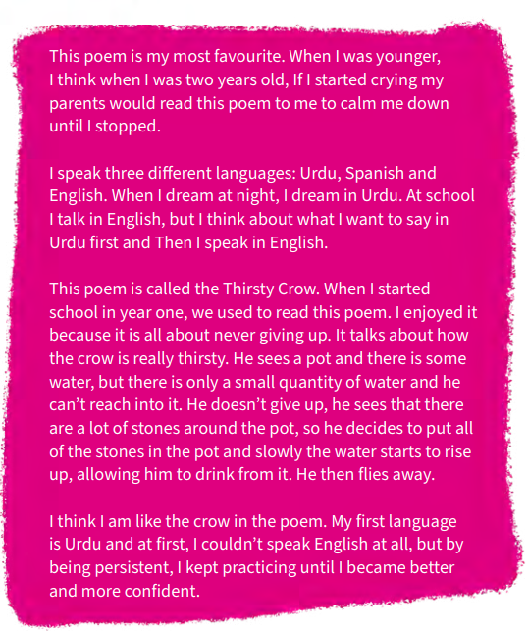
What is a shape poem?
A shape poem is a poem that creates the shape of the subject being spoken about.
They can either fill out the inside of the shape or create the outline of the shape.
Notes:
Thirsty Crow my Harm Arshad (Y7) – taken from MTOT Anthology 2022 p.g. 9
Google Translate have an app that will allow you to take pictures of the image and it will translate pictures.

Slide 4
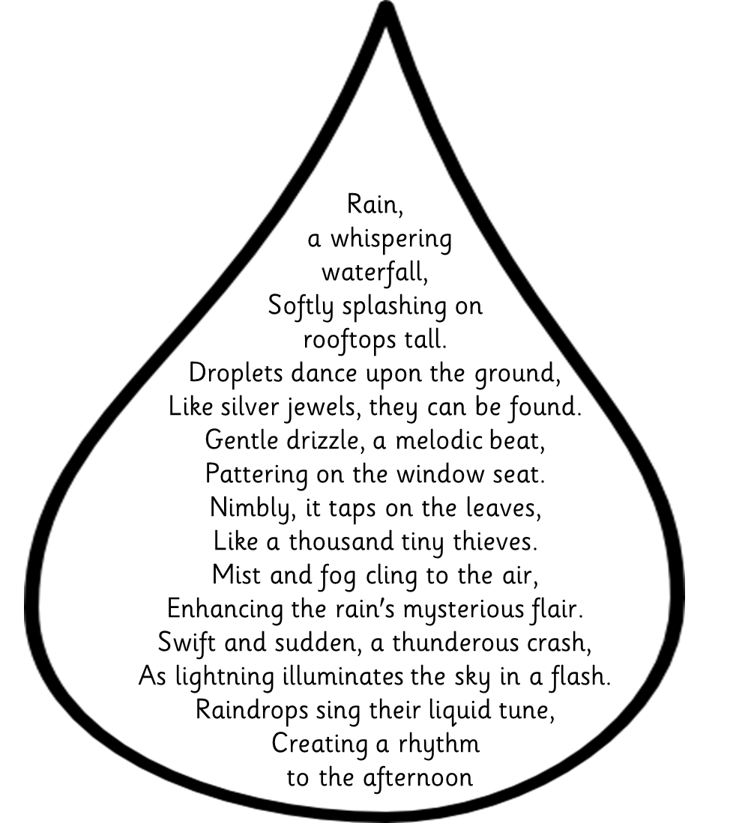
Notes:
Poem by P. Thobois, edited using Chat GPT – written to expected year 4 student level. Have students read through this and identify features within the poem. Ask them if they can see the shape of the raindrop in the poem (shape of the subject).

Slide 5
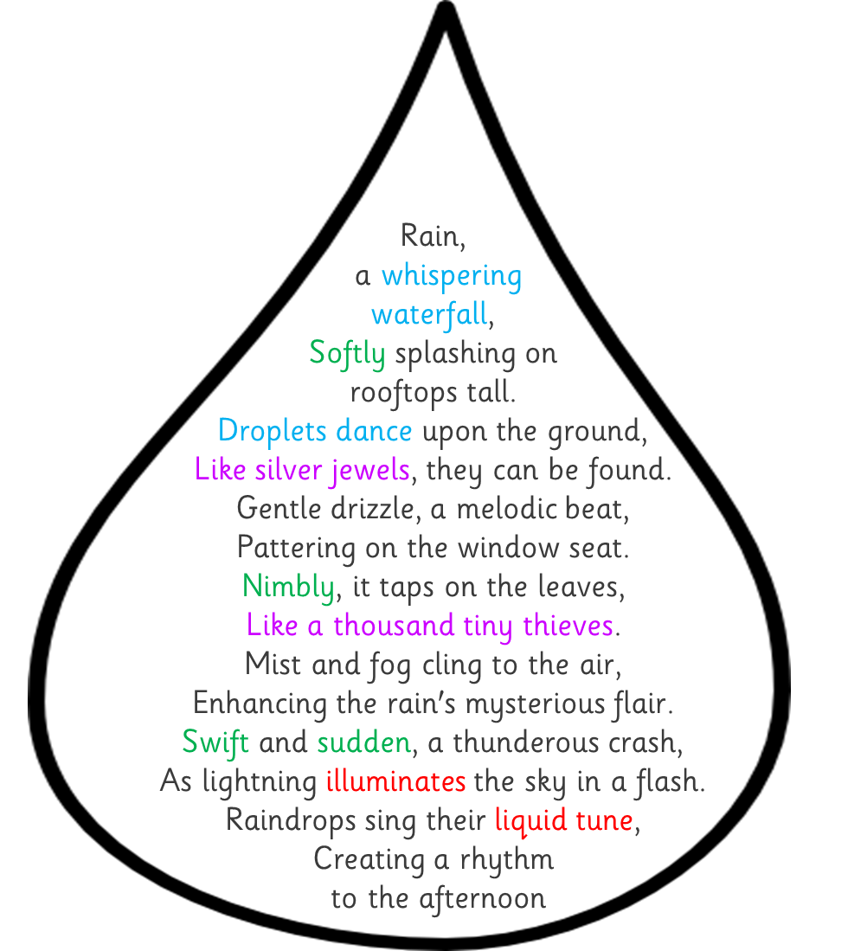
Capital letters and full stops can be used in your poem.
Each line can be different lengths to fit the shape of the subjects.
Lines do not have to rhyme but they can.
Alliteration
Similes
Adverbs
Powerful words

Slide 6
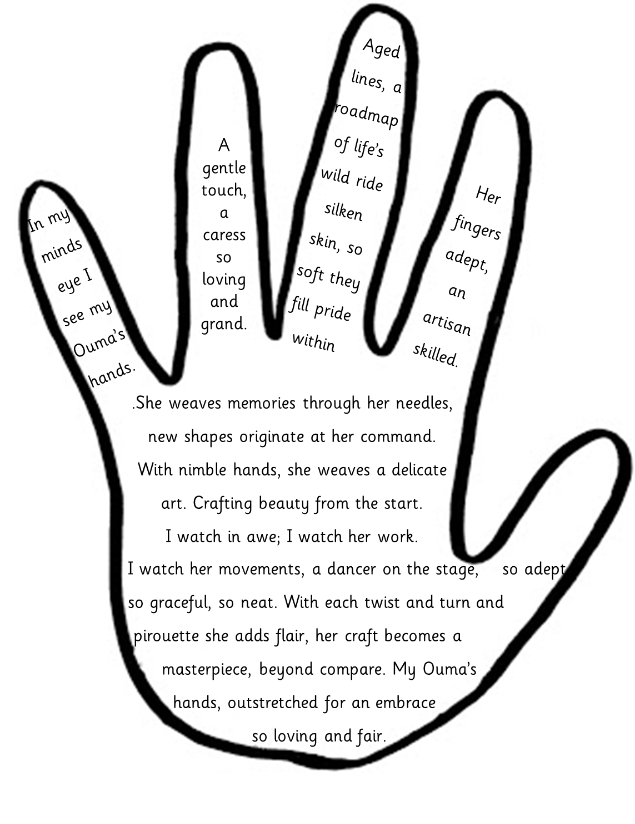
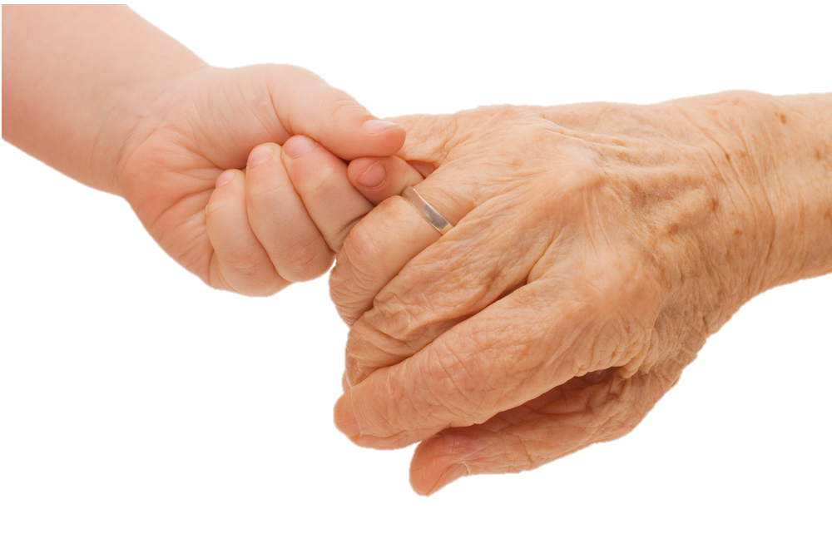
Notes:
Poem by theme by P. Thobois, edited by ChatGPT– written to expected year 7 student level (GD year 6).

Slide 7
Writing a shape poem
Need to consider how long your poem is – will it make the outline of the shape, or will it be the fill of the shape?
What features can we include?
Similes
Alliteration
Powerful adjectives
List of adverbs
A range of sentence lengths
Use your notes on what you would give an alien and why it describes you.
Try think of similes and alliteration for your item.
Notes:
When reviewing the success criteria, you can adjust the features children need to include (if you want a strict criteria, can be more free flow).
Once children have had a go identifying features in the poetry, start them on their writing. Depending on the cohort you can adjust the amount of free time children have with writing. You can pull them back to share ideas (magpie), for you to help model ideas or to help keep the lessons more structured.

Slide 8
Translating
Now you have your poem in one language, try to translate it into another language. Don’t worry if you make a mistake, it can be edited later.
Does it fit the original style of your poem?
You may need to look up synonyms to help with the flow of your poem.
You may need a bilingual dictionary to help with translation.

