Slide 1
Poetry

Slide 2
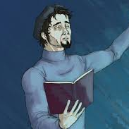
What do you think poetry is?
Take a few minutes to reflect and write down what you think poetry is. Think about what it is used for, what makes up a poem and different styles of poetry.
The official definition of poetry is a type of writing that uses language to express imaginative and emotional qualities instead of or in addition to meaning

Slide 3
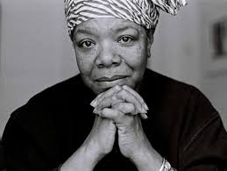
Which of the following are poetry?
You may write me down in history
With your bitter, twisted lies,
You may trod me in the very dirt
But still, like dust, I'll rise.
Got a long list of ex-lovers
They'll tell you I'm insane
But I got a blank space baby
And I'll write your name
-Maya Angelou (Still I Rise)
-Taylor Swift (Blank Space)
The place is full of worshippers.
You can tell by the sandals
piled outside, the owners’ prints
worn into leather, rubber, plastic,
a picture clearer than their faces
put together, with some originality,
brows and eyes, the slant
of cheek to chin.
God's plan, God's plan
I hold back, sometimes I won't, yuh
I feel good, sometimes I don't, ay, don't
I finessed down Weston Road, ay, 'nessed
-Drake (God’s Plan)
-Imtiaz Dharker (Prayer)
They are all examples of poetry! Even songs and raps are a type of poetry. Some poems rhyme while others don’t at all. Poetry can take many forms. Do you recognise any of these ‘poems’?

Slide 4
Remembering our definition of poetry, it is all about expressing imagination and emotion!
Using the below poem, pick 2-3 lines and discuss what images are created and how it makes you feel.
Habits of My Homeland by Thalaya Darr
Notes:
For full version you can listen here: https://soundcloud.com/realitycheat/habits-of-my-homeland

Slide 5
Writing a poem
Before we begin writing we need to tap into our emotions
For each emotion, you have 3 seconds to make a face for that emotion.
Happy
Sad
Jealous
Hopeful
Angry
Now choose an emotion, it can be one we have looked at or any other emotion

Slide 6
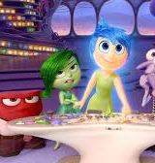
Write down what your emotion would be like if it was physical object/creature?
What colour would it be?
How big would it be?
Would it be warm or cold?
Would it feel hard or soft?
What would it sound like (think of music)?
Is it loud or quiet?
If you don’t feel like writing yet you can draw your emotion!

Slide 7
Writing a poem
Think about home.
Where is home?
Have you lived in more than one home?
Is home just a place?
Are there places where you feel at home?
How does home make you feel?
Write about home and how it makes you feel. Also think about past homes or other people’s homes and all the things associated. Describe your emotions, think about some of the answers used in the last exercise to do this.

Slide 8
Write a poem
Using your answers for the last two exercises, write a poem about home!
Think about the colours, language used, food eaten and everything else you associate at home.
You can write the poem however you want. It doesn’t have to rhyme. You could even write a song/rap!

Slide 9
Trying a new language!
Try translate the poem into the target language. Just do what you can for now. Don’t worry about making mistakes. You can change it later!

Slide 10
Writing in a new language
Using help from your teacher/the internet/a parent, try translate the rest of your poem
Does it still fit the style you originally wrote it in?
You may want to look up synonyms or change parts of it to make it flow better
Play around a bit and explore new styles
You can even choose a new word or character if you want
Be creative and have fun!

Slide 11
The Final Touches
The Final Touches
Once complete: ask a parent/teacher/friend to check it for you and correct any mistakes
See if you can translate it back to English
Once this is done you can decorate it by drawing and adding images/patterns to your piece.

