Slide 1
An Ode to …
Suitable for KS2/3

Slide 2
What is an Ode?
An Ode is an old style of poetry coming from Ancient Greece.
They are used to ‘sing’ about something that you love, admire or appreciate.
They are used to convey a lot of positive emotions.
Notes:
Introduce Ode’s to class.
Some children may already be familiar with what and Ode is – see if they can name any well-known odes.
The main purpose of an Ode is to celebrate the authors love for the subject and will include big, bold and flamboyant language that pulls the listener in.
Children struggling to build big emotions / convey passionate emotions?
Have children play a game of emotion charades to get them to understand the that the poems are to be performed. Children should be given an emotion and they have to enact it without any words (can use sounds if needed). Challenge students by using synonyms for different emotions (building vocabulary). NB: Include words in different languages.
E.g.,
Exhilarated (excited), Ecstatic (overjoyed), Jubilant (triumphant), Devastated (very sad), Mournful (weepy) etc.
OR
Give students a simple emotion and then students can be given ‘extra points’ for different synonyms.

Slide 3
What do I want to confess my love for?
My home
My language
My experiences
My favourite food
Notes:
TEACHER NOTES
Ask children to create a list of things they would confess their love for.
You could take 5 minutes gathering ideas from children as a whole and then give them 10 minutes to pick 2-3 subjects and list out a range of reasons as to why they love something. They will use this later when creating their own ode, encourage them to use personification, similes, metaphors etc (this will explained later and they can add to their lists at any point during the session).
Possible other ideas:
Favourite time of day (a specific hour, dusk, dawn, etc.)
Favourite food made by someone for you
Favourite spot in the neighbourhood
Favourite spot in the city
Favourite day of the week
Favourite season
Favourite subject in school
Name an idiosyncrasy you have
Name what you do on saturday night
Favourite family ritual
Favourite thing on your city’s calendar
Favourite slang
Something you leave the house with everyday
Favourite item of clothing when you want to look fresh

Slide 4
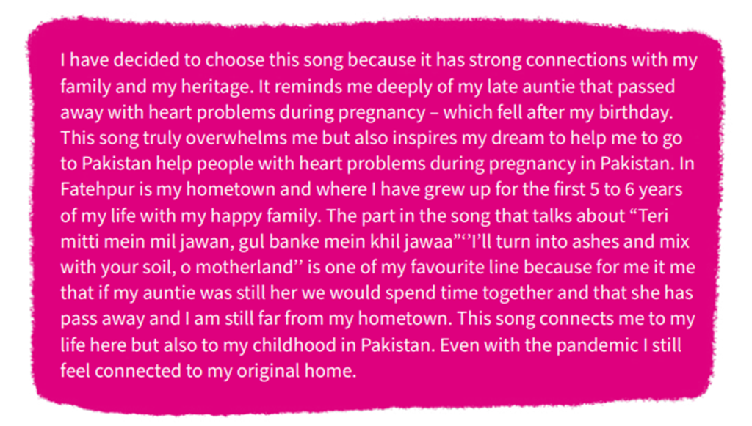
This is a poem from one of the children who had previously entered the competition.
Whilst it is from a song it bares similar features to an Ode.

Slide 5
Challenge
Can you identify the literary devises used in this Ode?
Personification
Similes
Metaphors
Alliteration
Words to show celebration/praise
Notes:
Read out the following ode to children once they have been presented the poem.
What is the poem about?
How do you feel the author feels about the subject?
What is the subject?
Have children highlight the following features:
Personification
Similes
Metaphors
Alliteration
Words to show celebration/praise
Powerful adjectives

Slide 6
Oh, my old home, you were so cool!
I'm going to write an ode, just for you.
In Africa, where the sun was hot,
Our house stood strong, like a superhero's spot.
The sand outside was all dusty and brown,
I'd kick it up as I ran around.
The trees had bark like paper, it was weird,
But they gave us shade, and that was cheered!
Sometimes, there'd be thunder, and lightning too,
It scared me a bit, but I loved the view.
The sound was like drums, so loud and wild,
And the flashes of light and then I smiled.
But the best part, oh, the best of all,
Was the smell on summer nights, like a magic call.
The wind carried scents that made me dream,
Jasmine, musk, and secrets it would seem.
I left that house, but it's still in my heart,
A treasure of memories, a special part.
I'm growing up now, and things have changed,
But my old home's love will never be exchanged.
So, here's my ode, just for you, dear place,
I'll always remember your warm embrace.
I'm grateful for the love and joy you brought,
My childhood home, forever in my thought!
Notes:
Poem by P. Thobois (creator of ppt – free to use as wanted)
Ask children to see if they can suggest how to uplevel this poem? (Note this poem is slightly restricted because the author has chosen to use a rhyming scheme).
Can you think of a metaphor to replace a simile?

Slide 7
Oh, my old home, you were so cool!
I'm going to write an ode, just for you.
In Africa, where the sun was hot,
Our house stood strong, like a superhero's spot.
The sand outside was all dusty and brown,
I'd kick it up as I ran around.
The trees had bark like paper, it was weird,
But they gave us shade, and that was cheered!
Sometimes, there'd be thunder, and lightning too,
It scared me a bit, but I loved the view.
The sound was like drums, so loud and wild,
And the flashes of light and then I smiled.
But the best part, oh, the best of all,
Was the smell on summer nights, like a magic call.
The wind carried scents that made me dream,
Jasmine, musk, and secrets it would seem.
I left that house, but it's still in my heart,
A treasure of memories, a special part.
I'm growing up now, and things have changed,
But my old home's love will never be exchanged.
So, here's my ode, just for you, dear place,
I'll always remember your warm embrace.
I'm grateful for the love and joy you brought,
My childhood home, forever in my thought!
Notes:
Poem by P. Thobois (creator of ppt – free to use as wanted)
Yellow – Subject and opener
Green – Simile
Blue – Personification
Purple – Words to convey emotion
Ask children to see if they can suggest how to uplevel this poem? (Note this poem is slightly restricted because the author has chosen to use a rhyming scheme).
Can you think of a metaphor to replace a simile?

Slide 8
Writing an Ode
Person speaking to the subject of the poem (the first line of the poem should address the subject, usually starts Oh! (insert subject)
Repeated phrases e.g., ‘Oh! How I love…’
Use of numerous literary devices e.g., rhyme, personification, metaphors and similes.
They do not have a specific rhyming scheme, structure or style – it is up to you.

Slide 9
Stem Sentences
Oh! (subject), how you make me (feeling),
The way you (describe feeling/action)
How can I express (emotion) for the way you …
Notes:
Dependant on the subject children want to write about they can use the following stem sentences to help structure each stanza.
As a general rule, keep 4 lines to a stanza and the first stanza must introduce the subject and the last stanza must round off on the whole admiration for the subject.

Slide 10
Translating
Now you have your poem in one language, try to translate it into another language. Don’t worry if you make a mistake, it can be edited later.
Does it fit the original style of your poem?
You may need to look up synonyms to help with the flow of your poem.
You may need a bilingual dictionary to help with translation.

Slide 11
Stem Sentences en français
Oh! (subject) Comment j'aime
Tu me fais sentir (feeling)
Comment puis-je exprimer mon (emotions) pour la façon dont vous
Notes:
This is an example for how you can support students by giving them stem sentences in different languages to help them structure their poems.

